Slide 1
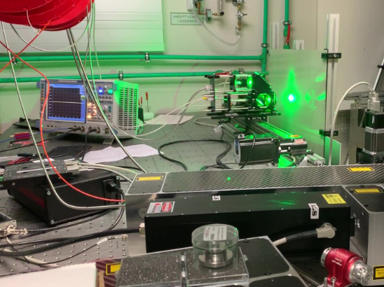
ACCURATe
Project Overview
Nathan Hartley

Slide 2

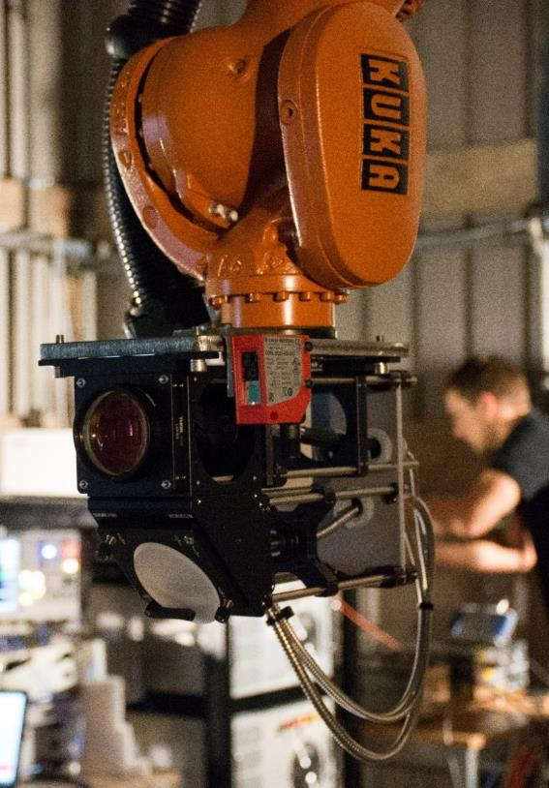
Introduction
Aerospace
Composite
Components
Ultrasonic
Robot
Assisted
Testing

Slide 3



The ACCURATe Project - Background
Part of Clean Sky 2 framework
Specifically “More Affordable Composite Fuselage”
EU’s Horizon 2020 research and innovation programme
c. €2M grant funding received
30 month project
Project commenced June 2017

Slide 4
The ACCURATe Project - Overview
Composites are key to reducing fuel costs and emissions
State of the art aircraft contain up to 80% by weight of composites in their load bearing structures
Two key barriers to overcome:
  (i) High cost of manufacture
  (ii) Increased risks of both internal defects and impact damage leading to structural failure
Hence the requirement for more efficient, effective and comprehensive inspection processes and systems

Slide 5




Project Partners
Topic Manager
ACCURATe Consortium

Slide 6
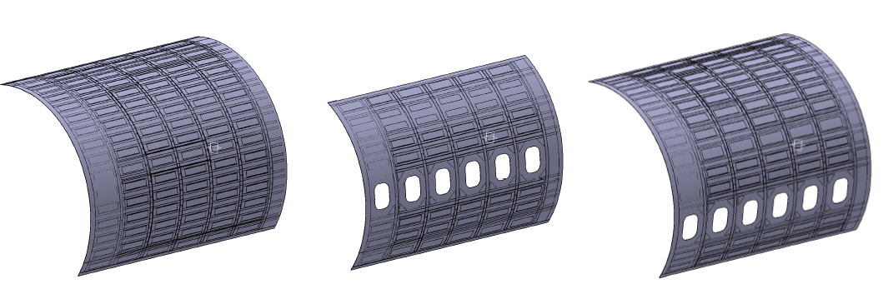
Project Aims
Develop a prototype laser ultrasonic testing (LUT) system for non-destructive inspection (NDI) of :
  Large scale aircraft hybrid and thick composite structures
  Structures containing acoustic damping materials
  Materials which highly attenuate ultrasound

Slide 7
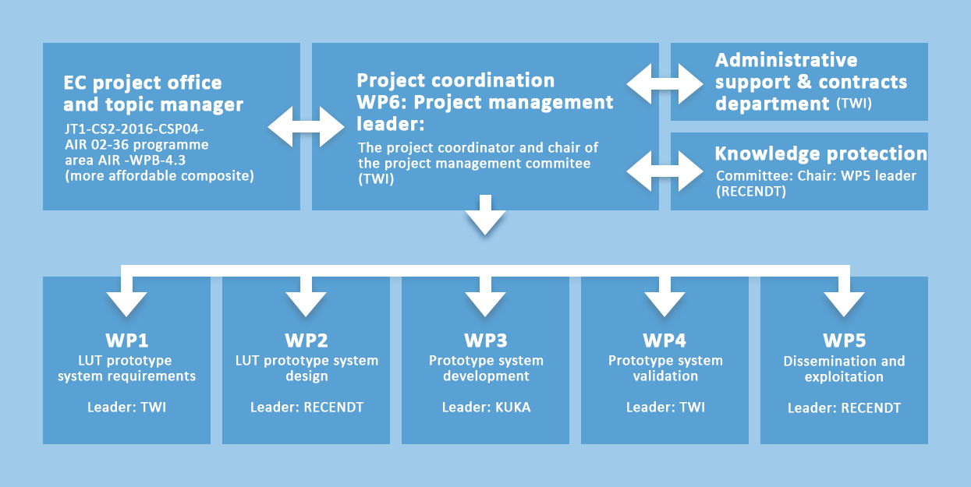
Project Work Packages
Current Work Package
Dec

Slide 8
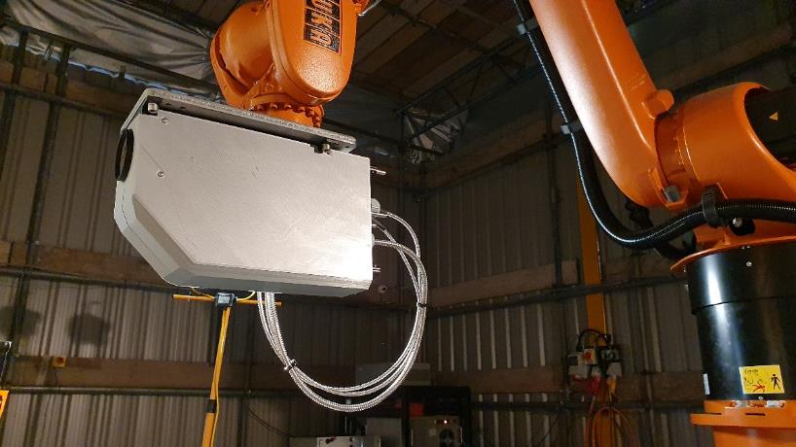
Advantages of Laser UT
High speed inspection process
Lightweight scanning head with small footprint
Broadband UT frequency generation
Low maintenance
High accuracy
Non contact
No couplant

Slide 9
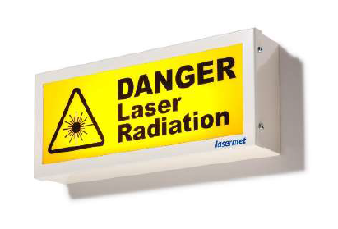
Challenges
Laser & robot safety
Inspection speed critical
Laser power optimisation
System vibration & noise
Multiple systems integration
Physical space constraints and robot reach

Slide 10
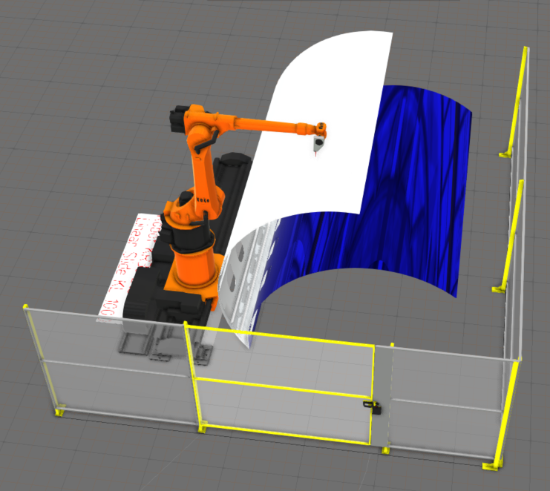
System Overview
6-axis robot mounted on linear track
Fibre coupled, pulsed generation and detection lasers
Interferometer and signal processing unit
Fully integrated software for laser & robot control, data acquisition and data analysis
Two position superpanel mounting fixture

Slide 11
Specification and performance*
Inspection cell size (m): 8 x 7 x 5 (W x D x H)
Inspection material types: Hybrid composite laminates
Largest component: c. 17m²
Maximum component thickness: 30ply + additional layers
Inspection rate: >8m²/h
Minimum detectable defect size: 6mm square
Robot positional accuracy: ±0.7mm
Robot pose repeatability: ±0.1mm
Minimum robot step size: 0.1mm
Scanning index: 0.5 - 3 mm (0.5 mm increments)
* Design parameters

Slide 12
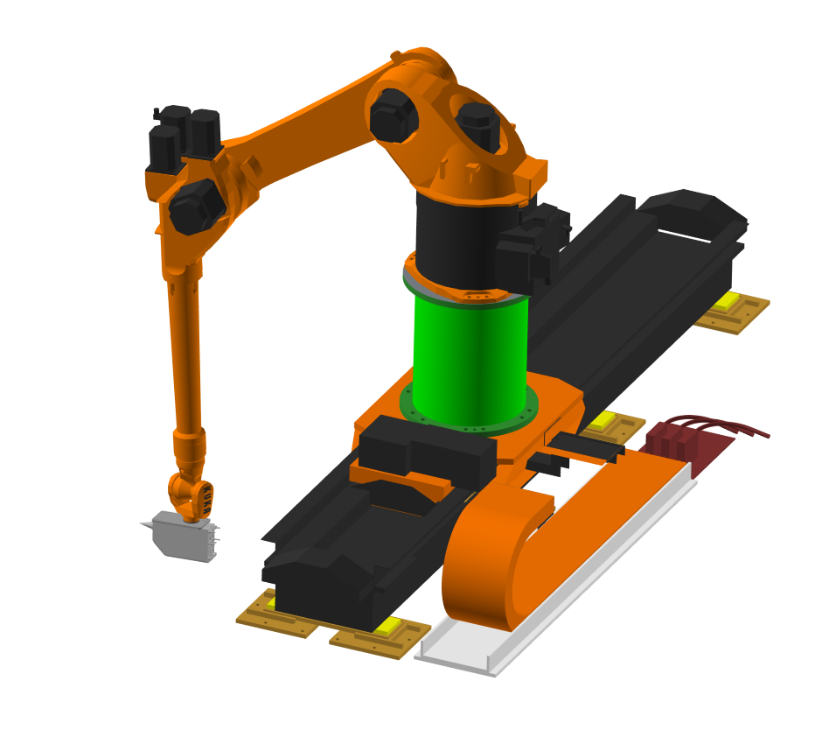
Robotic system
KR30-L16 robot manipulator
KL1000 Linear Track with 2700mm travel
KRC4 Robot Controller
5200mm wide loading doors & cell access doors
Integrated Fortress Interlock door locking / access system

Slide 13
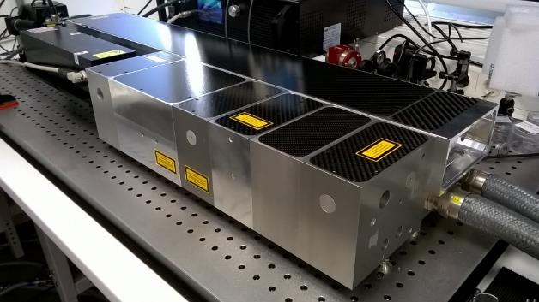
Laser Systems
Generation Laser:
  Type: diode pumped solid state laser
  Wavelength: 532 nm
  Pulse length: 10 ns
  Pulse repetition rate: 400 Hz
  Beam diameter: 4 mm
  Pulse energy 30 mJ (at fibre output)
Detection Laser:
  Type: diode pumped continuous wave / Nd:YAG laser
  Wavelength: 1064 nm
  Pulse repetition rate: 400 Hz
  Pulse length: 50 µs
  Pulse energy 35 mJ (at fibre output)

Slide 14
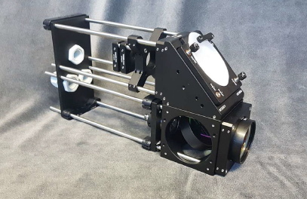
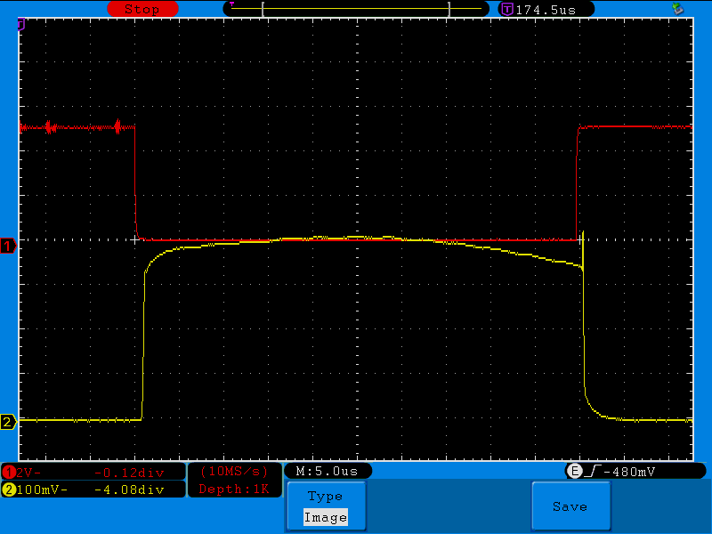
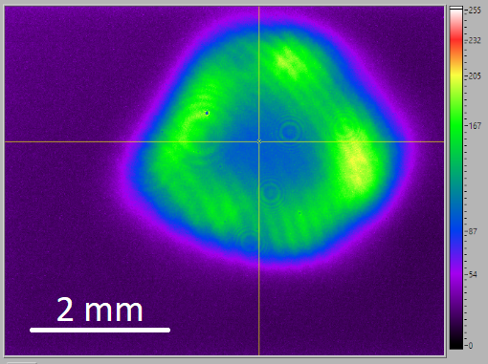
Optical Systems
Passive optical laser head
Fibre coupled to stationery two wave mixing (TWM) interferometer unit
Back scattered light from sample surface converted to amplitude changes
Amplitude changes measured by photodetectors (photodiodes)

Slide 15
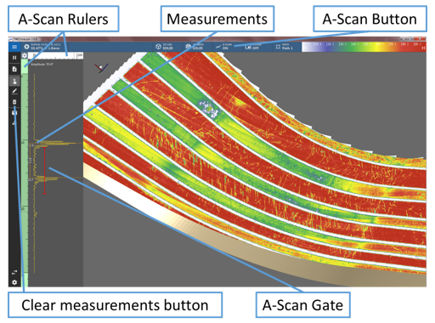
Software
Bespoke software for data acquisition, analysis and visualisation of inspection results
Display and analyse data in A-scan, B-Scan and 3D view
Offline data processing & visualisation
Full interaction with the 3D model
Indication logging and reporting

Slide 16
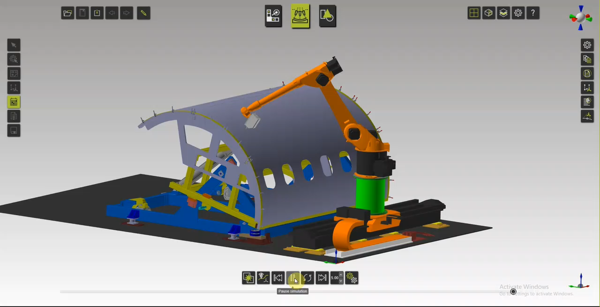


Offline Path Planning & Simulation

Slide 17
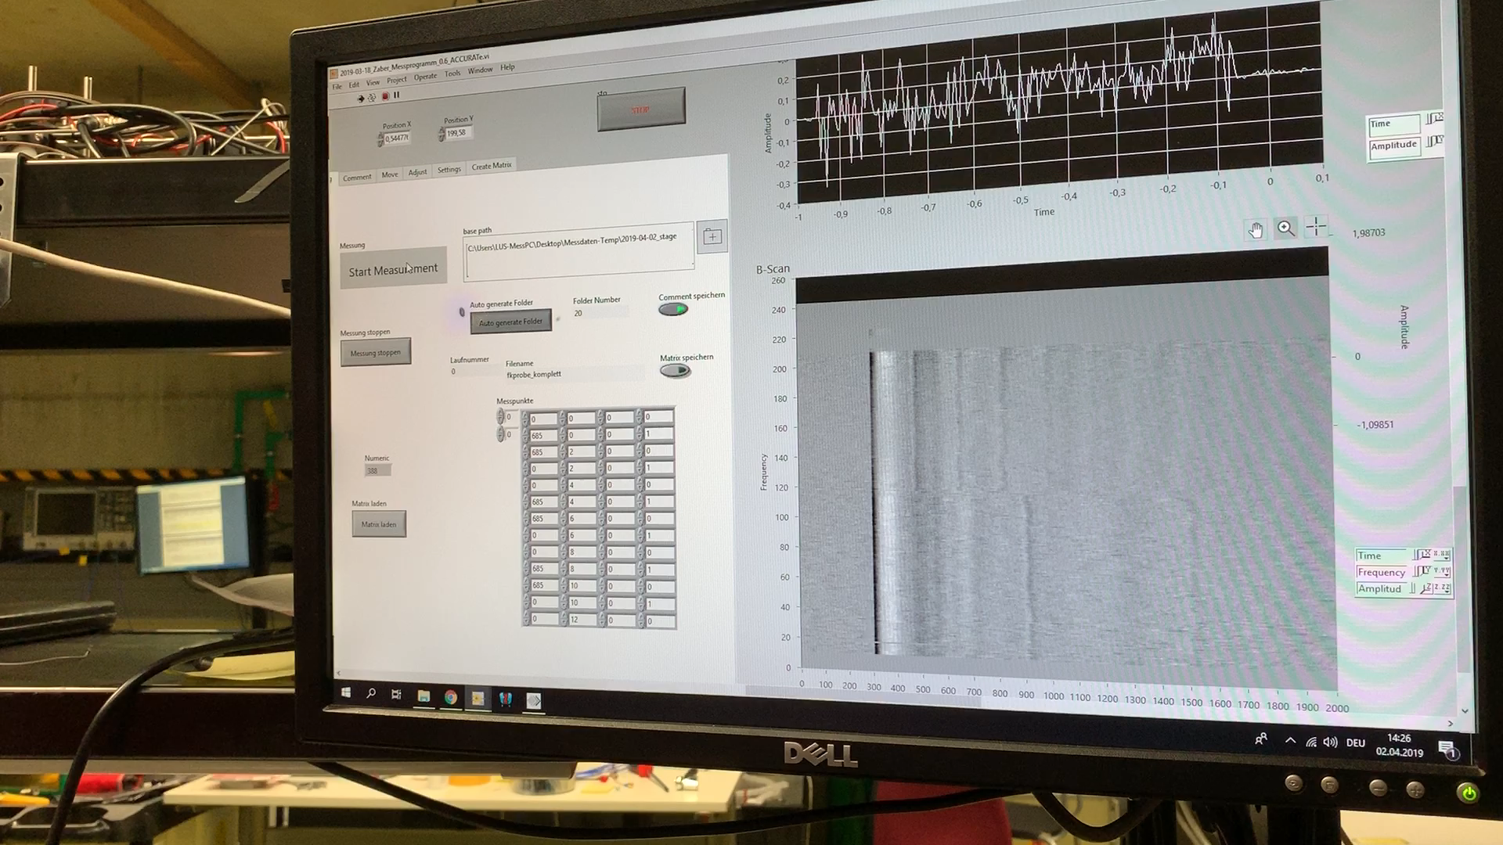
Bench Testing

Slide 18
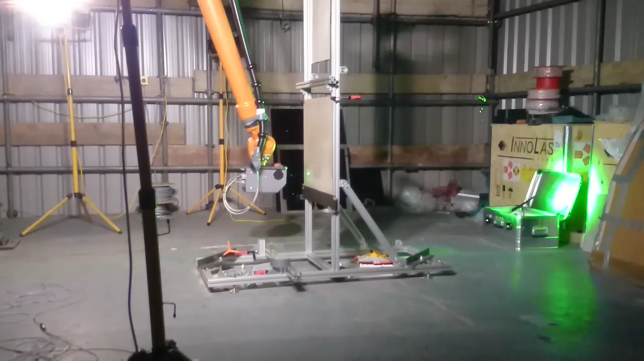
System Testing

Slide 19
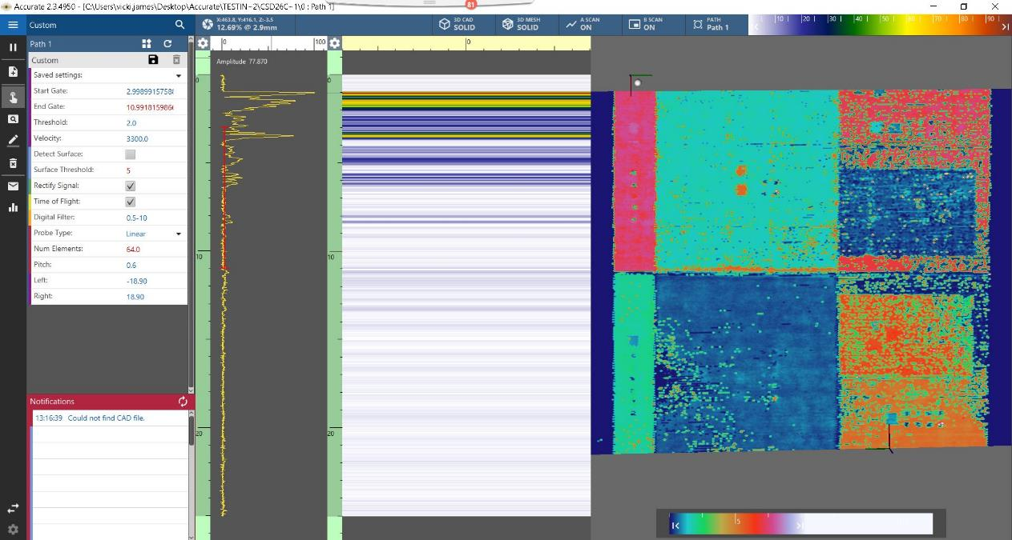
Ultrasonic results

Slide 20
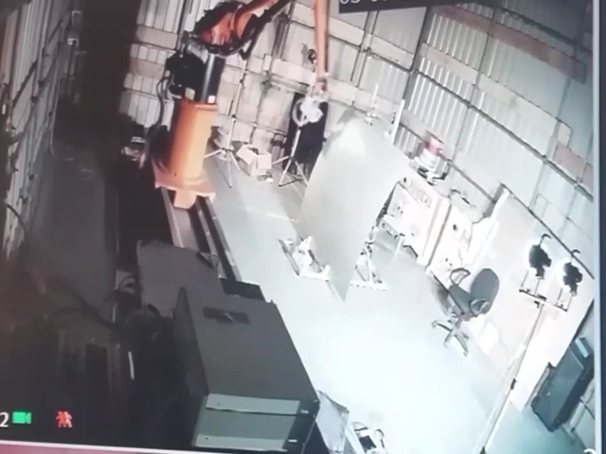
System Testing

Slide 21
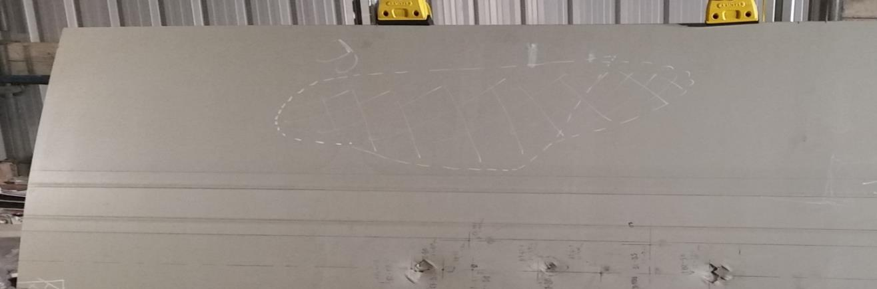
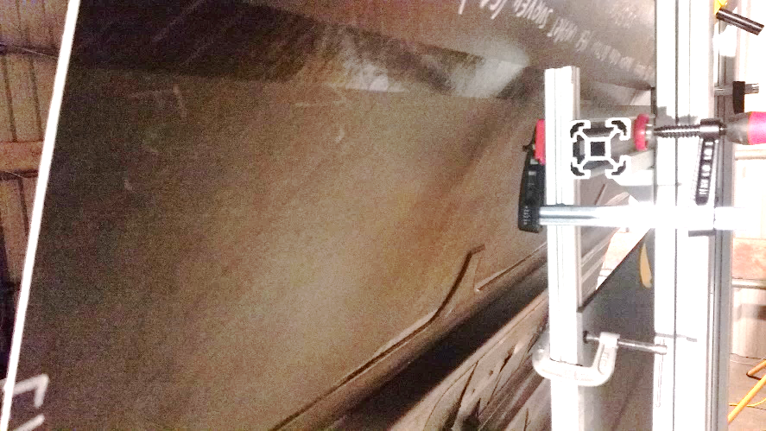
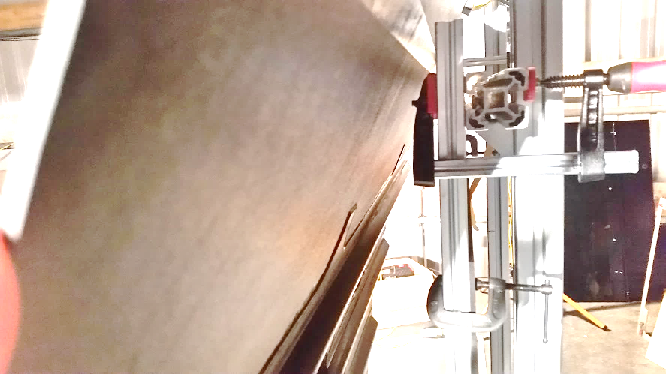
System Testing
Rear views of the panel showing stringers and ribs

Slide 22
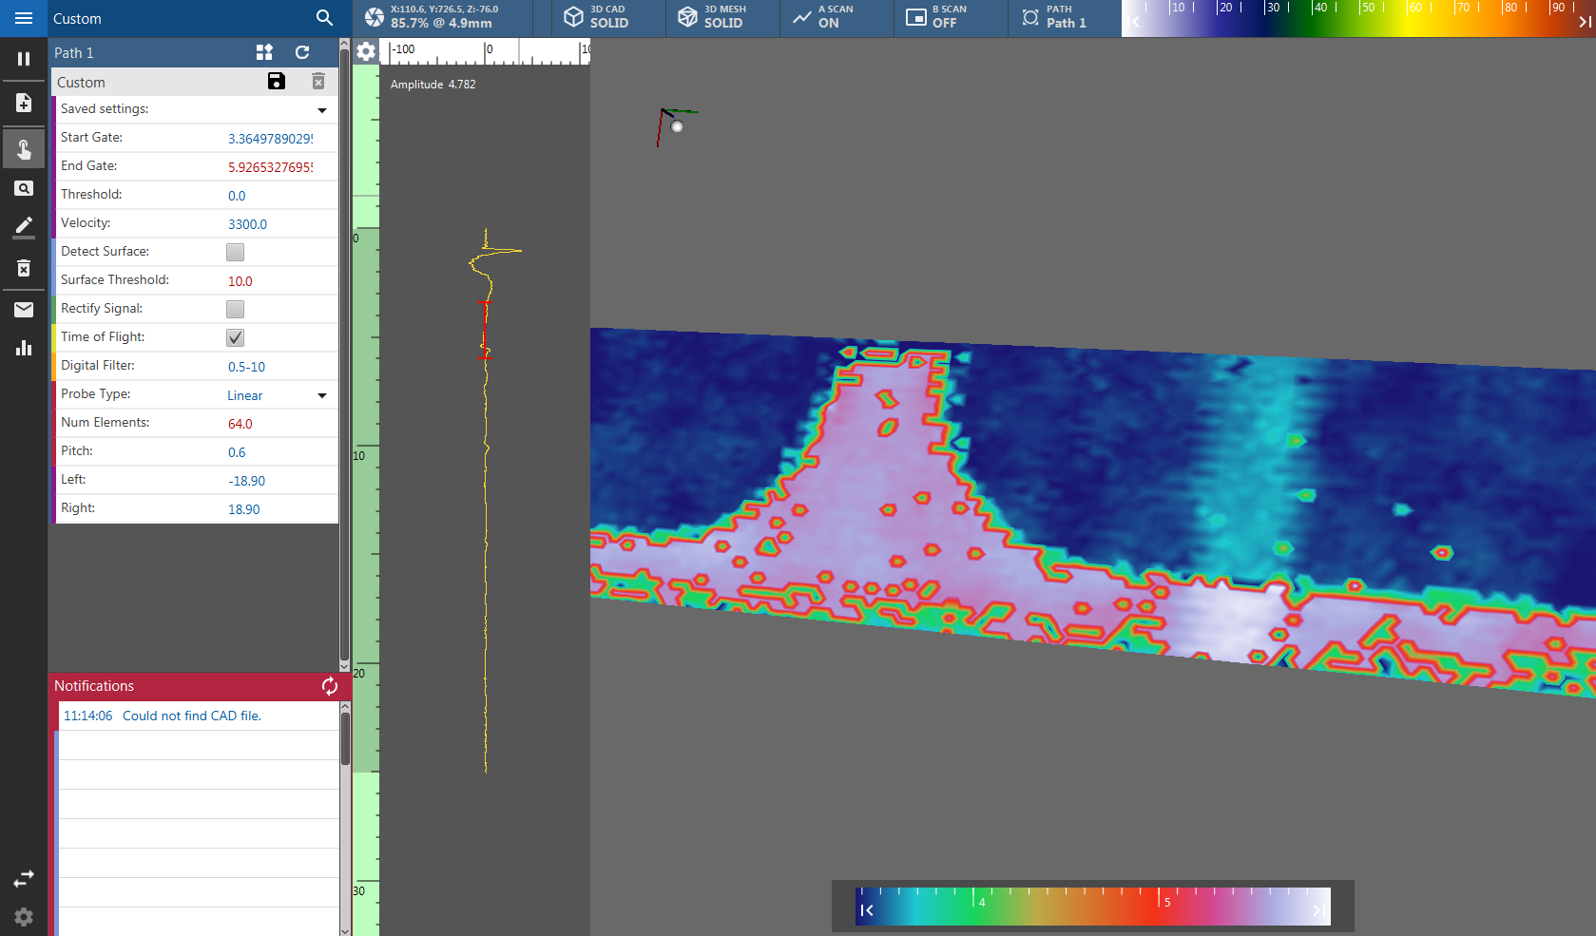
Ultrasonic results

Slide 23
Programme & Progress
Current status:
  Prototype LUT system commissioned
  LUT data acquisition and analysis software passed initial testing
  Proof of concept
Next steps:
  Complete integrated system tests
  Installation at Topic Manager site
  System validation trials & performance tests
  CE Marking
  Completion – Q1 2020

Slide 24

Questions ?
www.accurate-project.eu

Slide 25

Thank you for listening
nathan.hartley@twi.co.uk
+44 (0)1639 873100
+44 (0)7890 678785

